Slide 1
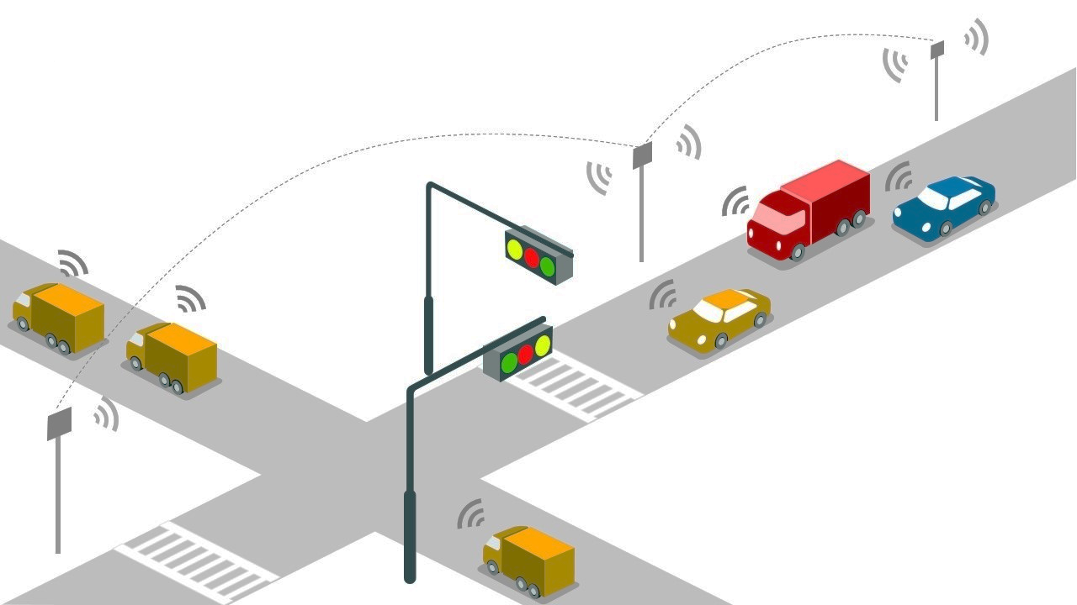


Intelligent Traffic Signal Control System for Emergency Vehicles
DEPARTMENT OF ELECTRICAL AND ELECTRONICS ENGINEERING
COIMBATORE INSTITUTE OF TECHNOLOGY
COIMBATORE.
UNDER THE GUIDANCE OF
Dr. S Vasantharathna
Professor & Head of the Department
Abhishek Shivram A - 1803002
Laleth I N - 1803031
Shaik Azamathulla - 1803055
Sivnandhini S R - 1803056

Slide 2





PROBLEM STATEMENT
Issues Related To Emergency Transport
Reports On Response Time
Increase In Vehicle Density
Deaths due to Delay In Service

Slide 3

OBJECTIVES
To provide a ‘Green Corridor’ for Emergency vehicles
Improving the response time of Emergency vehicles
To provide a way for the emergency vehicle without affecting the normal traffic flow
To ensure that they reach in time and also to reduce the fuel consumption
Improvising the traffic signal for the next generation

Slide 4
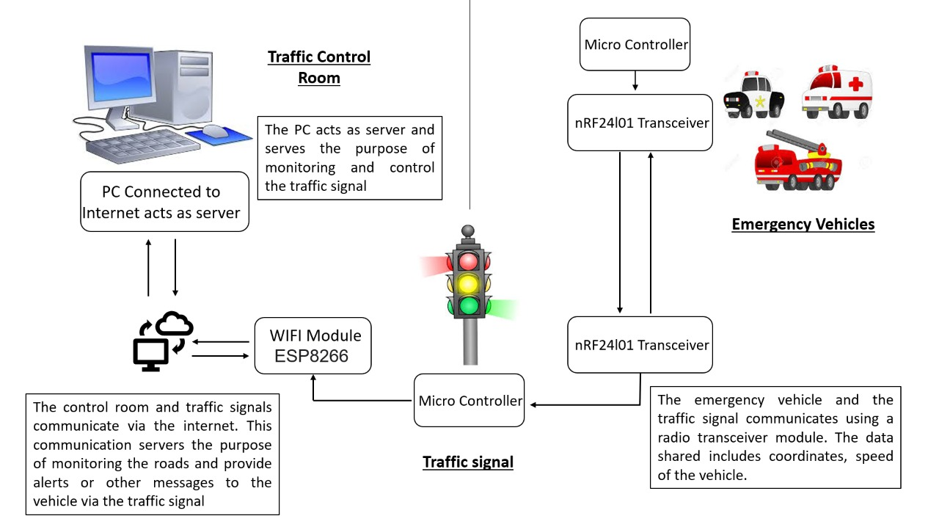
serves

Slide 5

LITERATURE SURVEY
AUTHOR/TITLE
METHOD USED
MERITS AND DEMERITS
V. Paruchuri, S. Chellappan, and R. B. Lenin, ‘‘Arrival time based traffic signal optimization for intelligent transportation systems,’’ in Proc. AINA, Barcelona, Spain, Mar. 2013, pp. 703–709.
K. Nellore and G. Hancke, ‘‘Traffic management for emergency vehicle priority based on visual sensing,’’ Sensors, vol. 16, no. 11, p. 1892, Oct. 2016

Slide 6
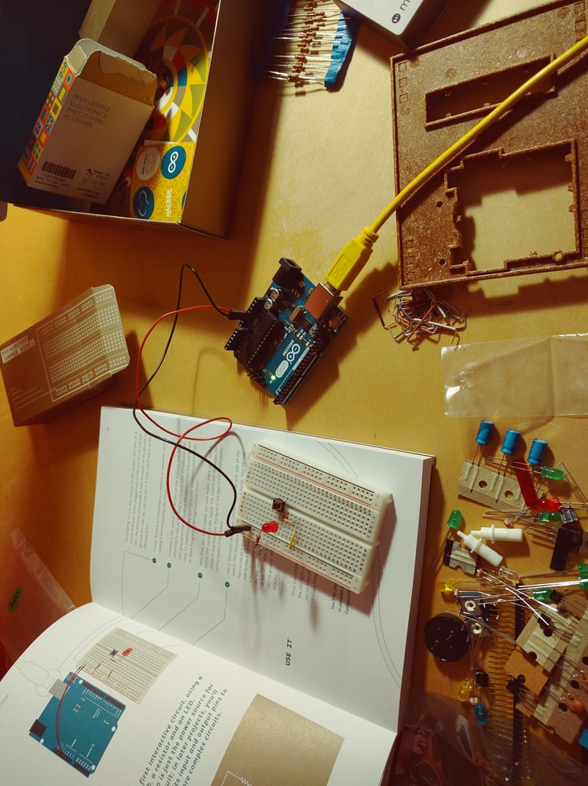
ARDUINO UNO
HARDWARE COMPONENTS
NRF24L01
WI-FI MODULE
ESP8266

Slide 7
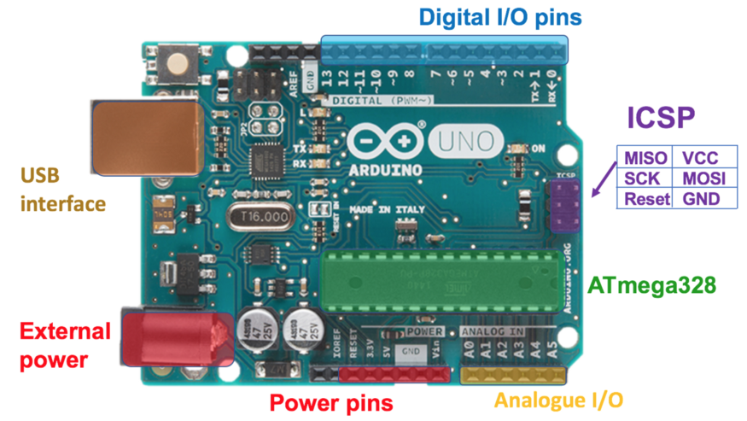
ARDUINO PIN DIAGRAM

Slide 8
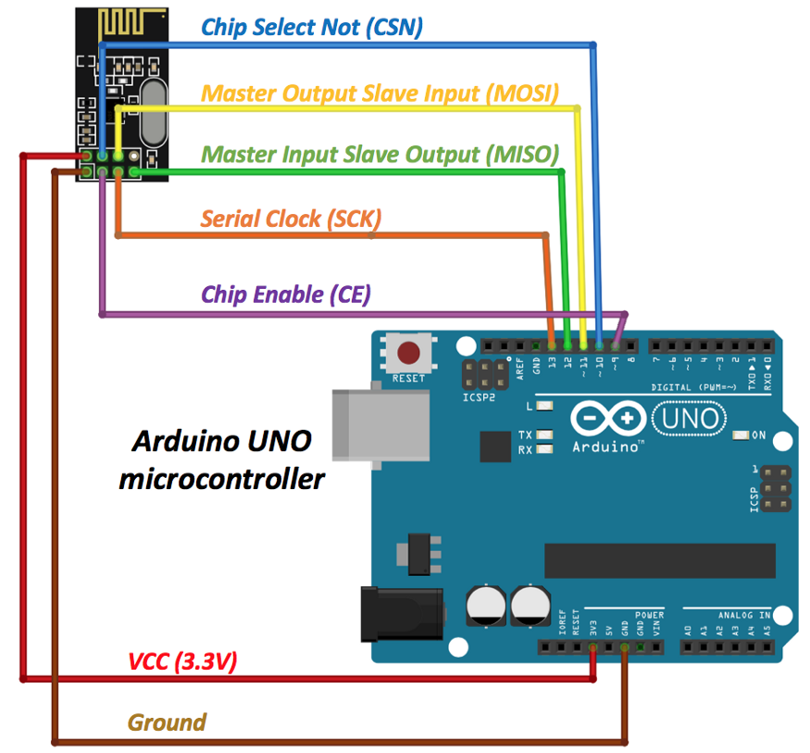
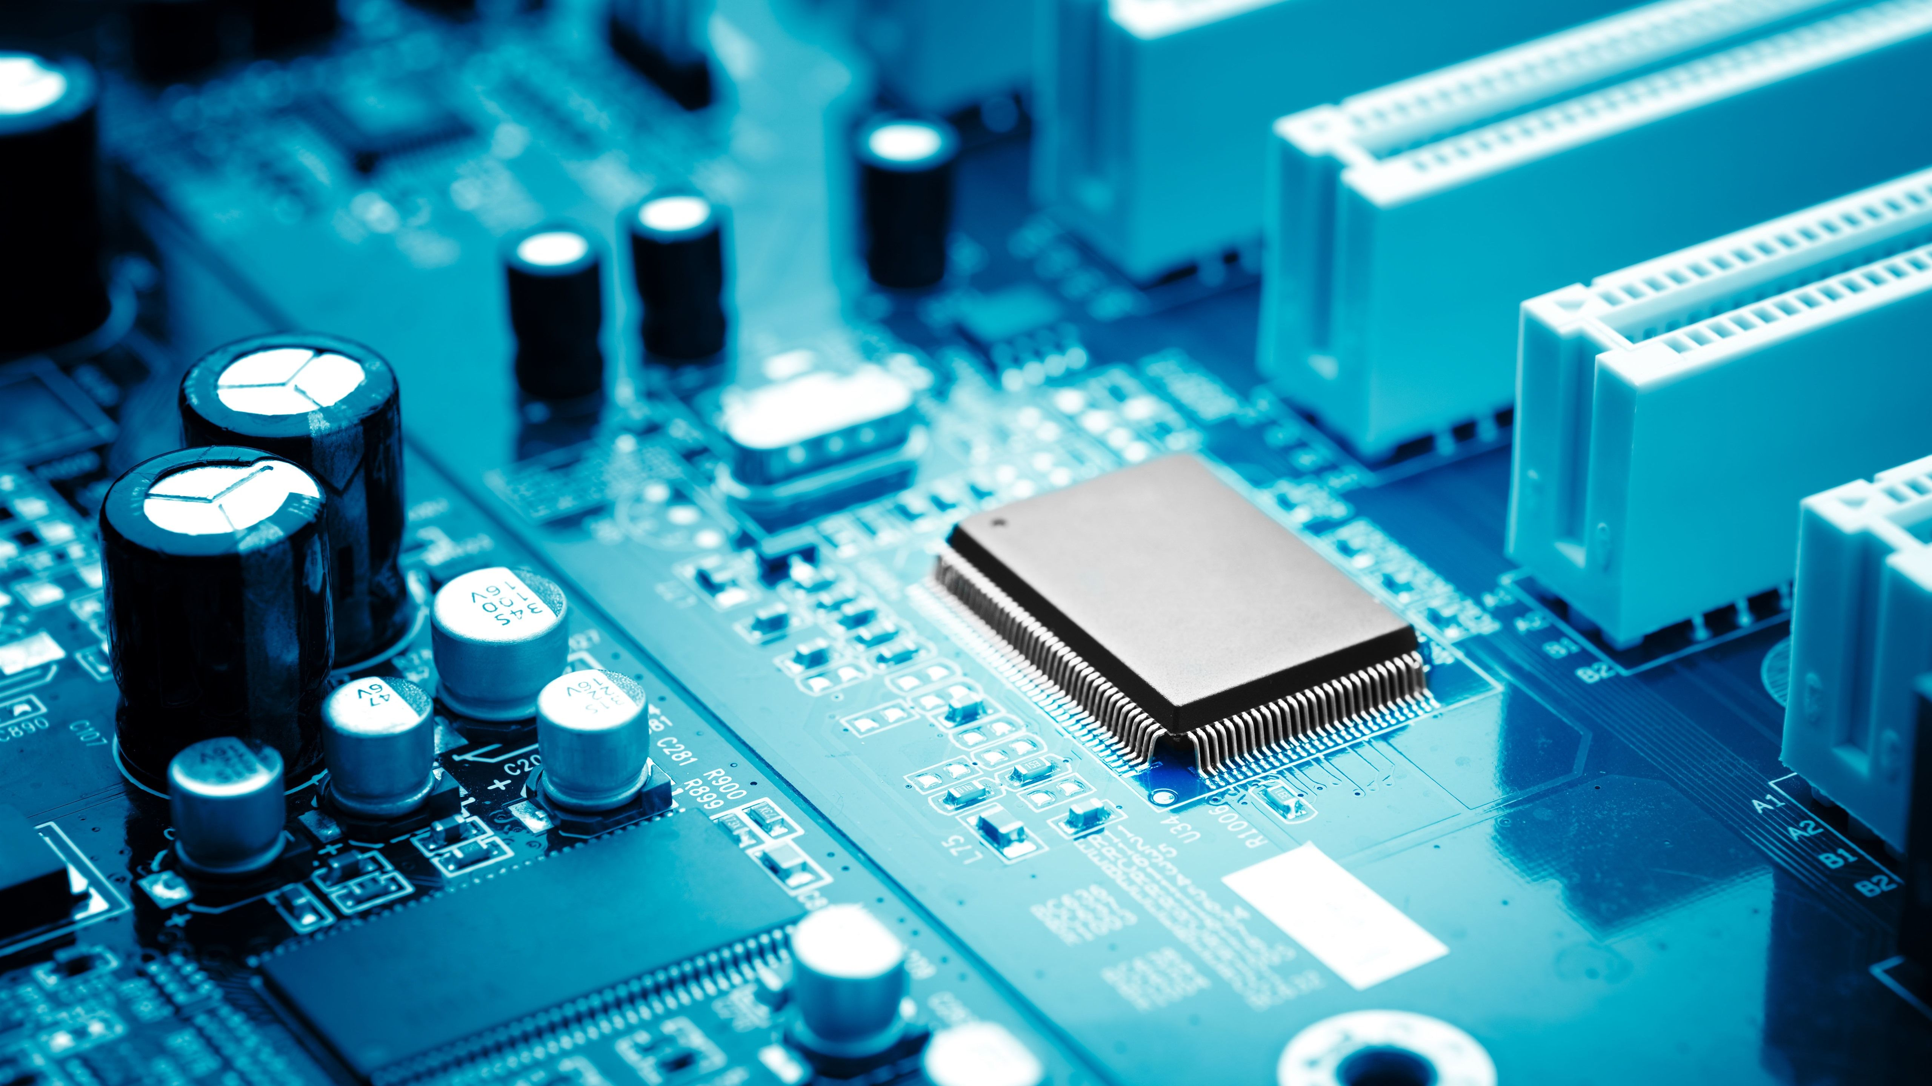
NRF24L01

Slide 9

SOCIO-ECONOMIC IMPACT

Slide 10
SUMMARY

Slide 11

REFERENCE
https://ieeexplore.ieee.org/stamp/stamp.jsp?arnumber=8523674
Predicting Ambulance Demand: Challenges and Methods
A COMPREHENSIVE SURVEY ON THE AMBULANCE ROUTING
AND LOCATION PROBLEMS
Analysis of Low Cost Communication Technologies for V2I Applications

